Slide 1
kMC model for Li ion/graphite
Workflow for autonomous Discovery of Battery Components
Maximiliano Gavilán

Slide 2
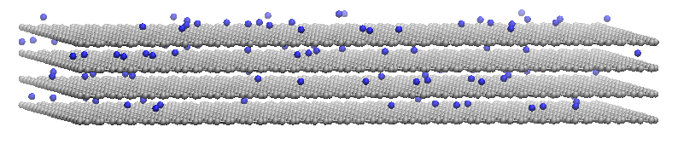
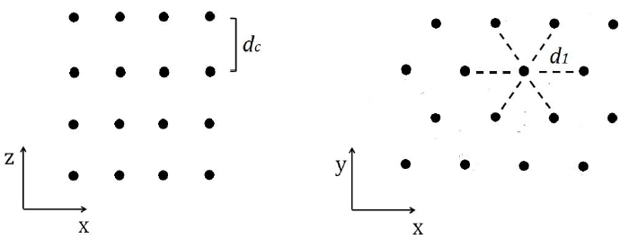
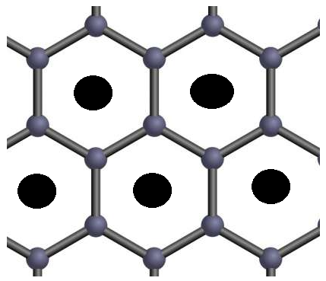
kMC general model
Wall
3 events are simualted:
- intercalation
- deintercalation
- diffusion
Intercalation only occurs at the left of the lattice (see figure)
Diffusion is limited to the size of the particle in the y axis
Periodic boundary conditions are applied in the x axis (not in y)
Layer-to-layer jumps are prohibited
Deintercalation
Diffusion
X
z
intercalation
Layer-to-layer jumps are prohibited
x
y
Graphite model
A perfect graphite particle is modelled with a lattice-gas, which is contructed with the “hollow” sites of graphite with AA stacking where Li ions intercalate (black points). This forms a pile of layers, each of them with a triangular geometry of fixed intercalation points
Each site is a “hollow” site

Slide 3


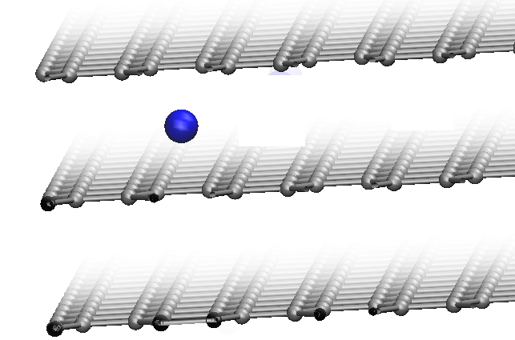



Rate constant equation
The rate for each of the events is calculated with the next equation, this equation emerges from transition state theory [1]. In kMC the rates are equivalent to transitions probabilities.
Hamiltonian of final and initial configurations of the lattice
[2]
Pre-exponential (vibrational) factor [3]
Energy barrier
We can also model a Hamiltonian with DFT
(second step?)
$${∆^{∗}}_{diff}$$
$${∆^{∗}}_{i/d}$$
Energy barriers to calculate with DFT!
[1] Mitchell et al. Journal of Electroanalytical Chemistry 493 (2000) 68–74
[2] E.M. Perassi and E.P.M. Leiva, Electrochemistry Communications 65 (2016) 48–52
[3] K. Toyoura et al. Phys. Rev. B 78 (2008)

Slide 4
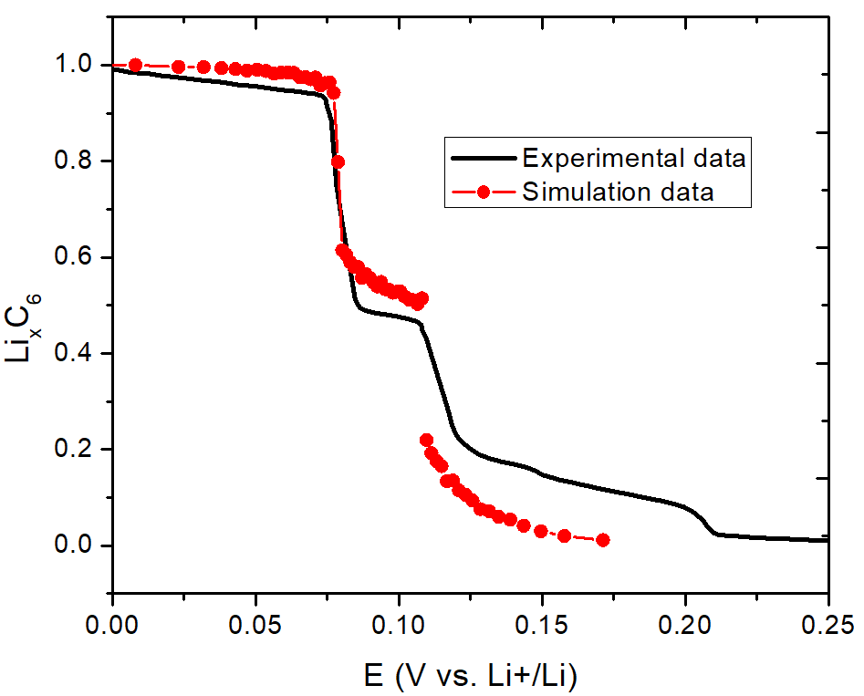
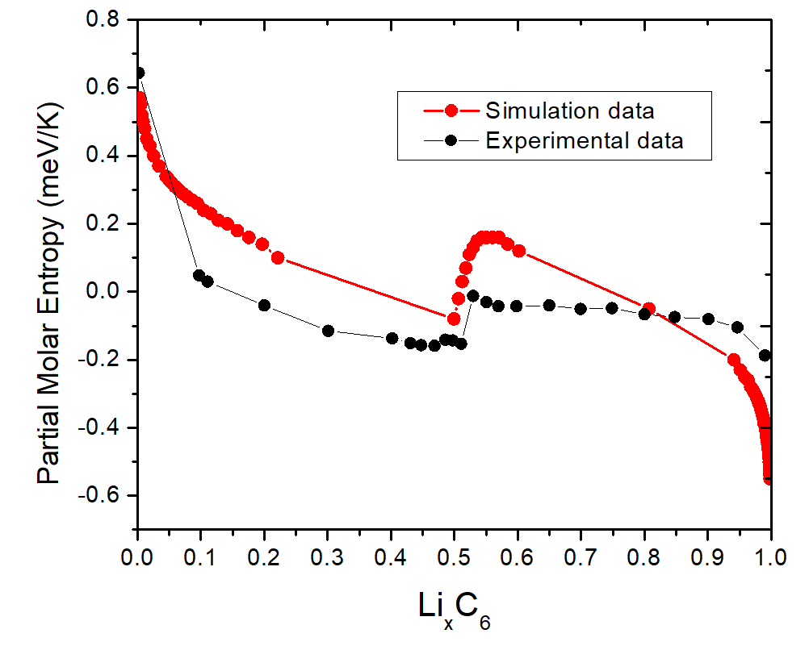
Hamiltonian details
We used a semi-empirical Hamiltonian developed by Perassi and Leiva [2] to reproduce stage 2-stage 1 transition (isotherm and partial molar for entropy profiles, see figure). Equilibrium grand canonical Monte Carlo simulations were used for this purpose.
[2] E.M. Perassi and E.P.M. Leiva, Electrochemistry Communications 65 (2016) 48–52

Slide 5
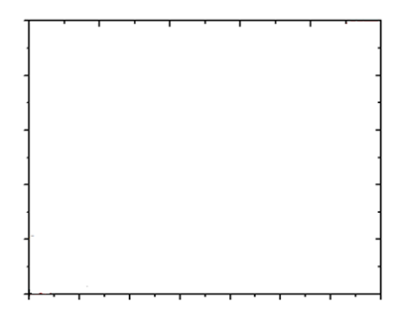
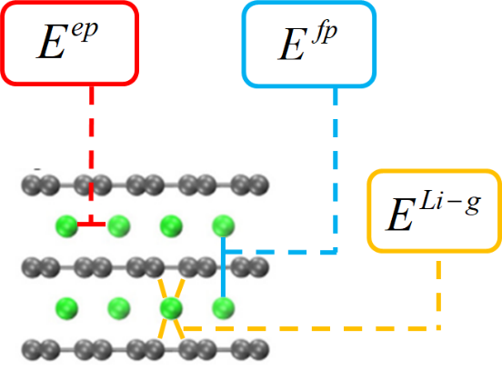
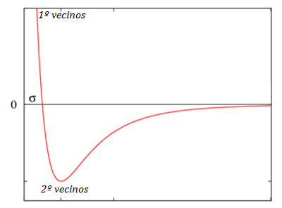






Hamiltonian details
Hamiltonian has three energy terms:
- interaction Li-Li in the same layer (red)
- interaction Li-Li in ions different layers (blue)
- interaction Li-C (yellow)
[2]
Repulsion term for Li-Li interactions in different layers
Lennard-Jones potential for Li-Li interactions in the same layer
$$E^{fp}(r_{ij})=κ{\left(\frac{r_{b}}{r_{ij}}\right)}^{α}$$
$$energy {Li}^{+}−{Li}^{+}$$
$$E^{ep}(r_{ij})=ε\left[{\left(\frac{r_{m}}{r_{ij}}\right)}^{12}−2{\left(\frac{r_{m}}{r_{ij}}\right)}^{6}\right]$$
$$energy {Li}^{+}−{Li}^{+}$$
$$r$$
Constant value
$$r$$
[2] E.M. Perassi and E.P.M. Leiva, Electrochemistry Communications 65 (2016) 48–52

Slide 6
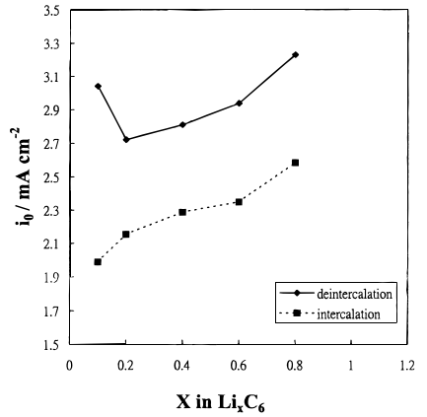
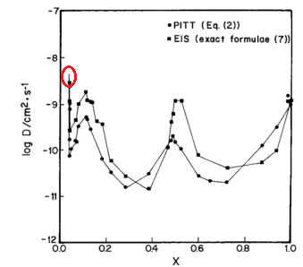

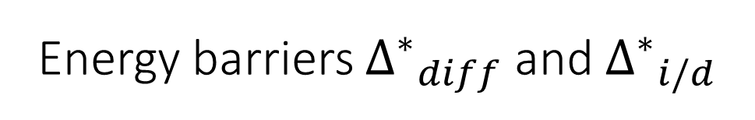
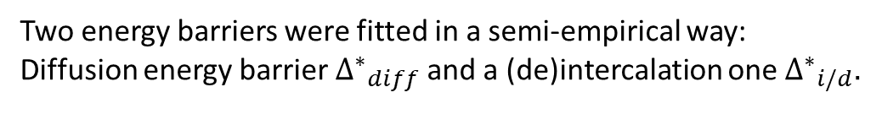

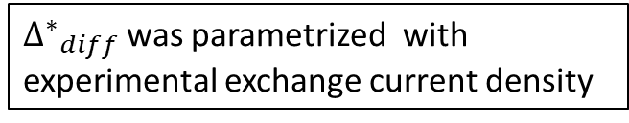
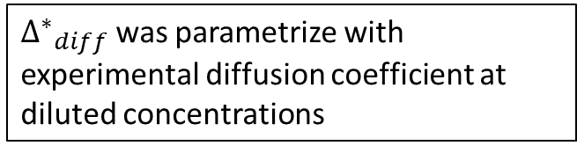
Energy barriers ${∆^{∗}}_{diff}$ and ${∆^{∗}}_{i/d}$
Two energy barriers were fitted in a semi-empirical way:
Diffusion energy barrier ${∆^{∗}}_{diff}$ and a (de)intercalation one ${∆^{∗}}_{i/d}.$
$${∆^{∗}}_{i/d}$$
$${∆^{∗}}_{diff}$$
Both barriers represent the energy that a single lithium ion need to overcome to perform an event in a totally empty graphite particle (empty of Li ions)
${∆^{∗}}_{diff}$ was parametrize with experimental diffusion coefficient at diluted concentrations
${∆^{∗}}_{diff}$ was parametrized with experimental exchange current density
$$\log\left(D\right)≈−8.34$$
M.D. Levi and D. Aurbach, J. Phys. Chem. B 1997, 101, 4641-4647
Chang et al. Journal of The Electrochemical Society, 147 (6) 2033-2038 (2000)

